Slide 1
Minor Project Code: 15ECSW302 Sem: VI Year: 2020-21
Project Title: Integer Factorization using Shor’s Algorithm
Team Number: S3
Team Members:-
Guide Name: Mr. KMM Rajashekaraiah
NAME | USN
Raj Jain | 01FE18BCS002
Aayush Rajwade | 01FE18BCS005
Aman Kumar | 01FE18BCS029
Ayush Utsav | 01FE18BCS059

Slide 2
Problem Statement
To do Integer Factorisation by using Shor’s Quantum Algorithm.

Slide 3
Objectives
To do integer factorization using Shor’s Quantum Algorithm.
To do factoring of integers with maximum possible probability.
To reduce the number of iterations.

Slide 4
Methodology

Slide 5
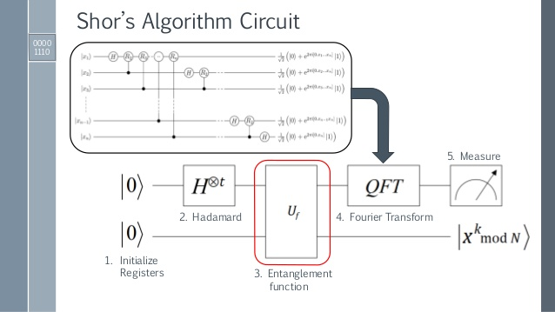
Component Level Design

Slide 6
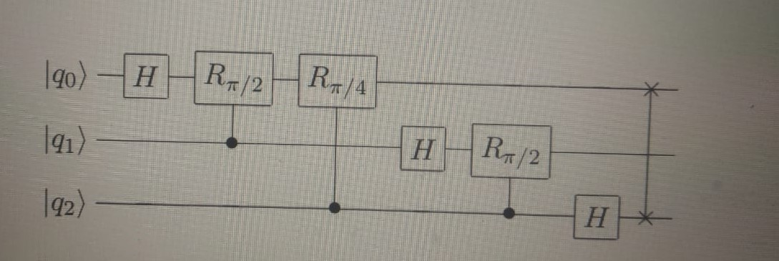
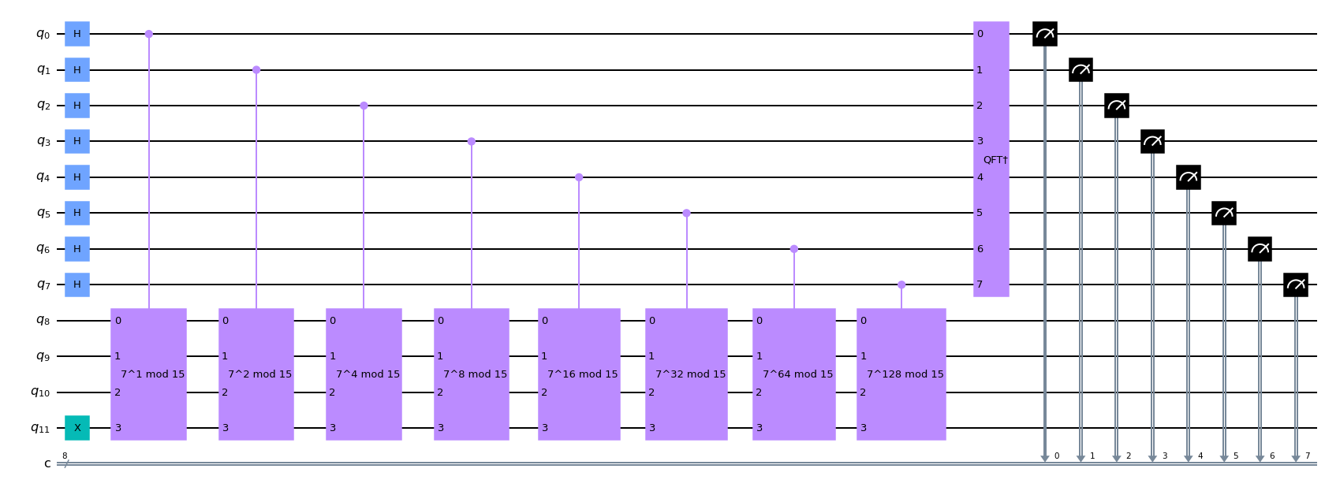
Difference b/w QFT and SQFT
QFT(Previous Approach)
SQFT(New Approach)

Slide 7
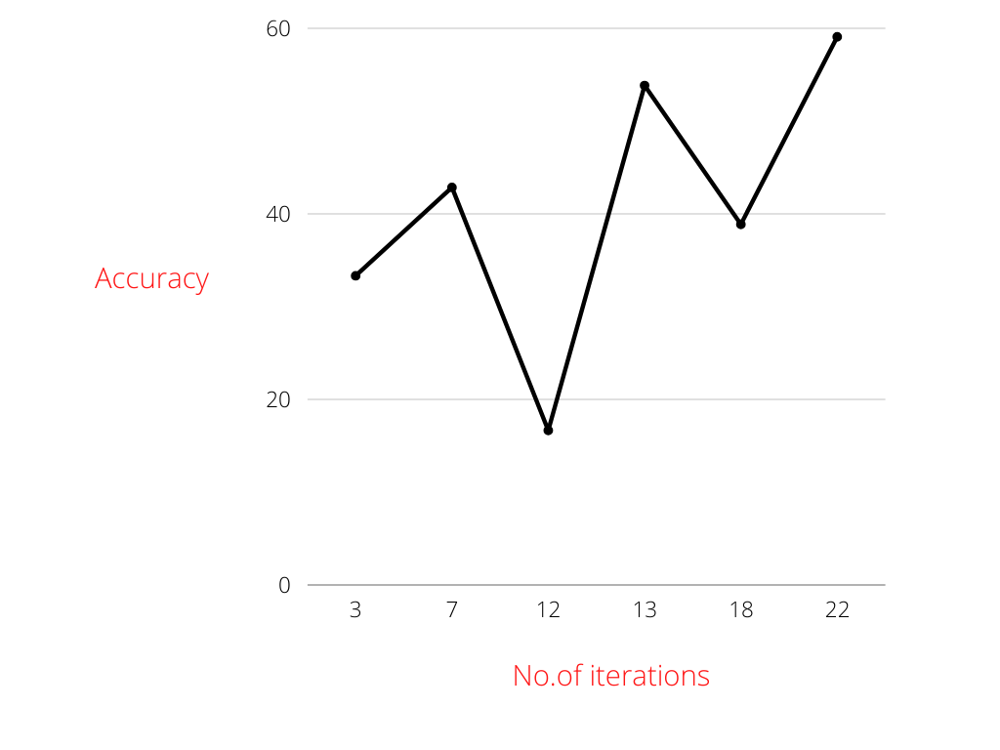
Result Analysis
This graph represents Accuracy (Probability success rate) VS no of iterations the algorithm ran.
The maximum accuracy achieved using SQFT is 59.0909% with iteration count of 22.

Slide 8
Demo of the Project
mark50.ipynb - Quantum Lab - IBM Quantum

Slide 9
References
Abhijith, J., et al. "Quantum algorithm implementations for beginners." arXiv e-prints (2018): arXiv-1804.
Speiser, Jacqueline. "Implementing and Comparing Integer Factorization Algorithms.“
Steiger, Damian S., Thomas Häner, and Matthias Troyer. "ProjectQ: an open source software framework for quantum computing." Quantum 2 (2018): 49.

Slide 10
Thank You !!!

